Slide 1


Ethan Skowronski
7/12/24

Slide 2
Outline
Executive Summary
Introduction
Methodology
Results
Conclusion
Appendix

Slide 3
Executive Summary
Summary of methodologies
Data collection with API and web scraping
Exploratory data analysis using data visualization
Exploratory data analysis using SQL
Creating dashboards with plotly dash
Predictive analysis
Summary of all results
Exploratory data analysis results
Interactive maps and dashboards
Predictive results

Slide 4
Introduction
Project background and context
This project was meant to predict if the Falcon 9’s first stage will successfully land. SpaceX says that the cost to launch the Falcon 9 is 62 million dollars. Some of SpaceX’s competitors can cost 165 million dollars to launch. The reason SpaceX has their price so cheap is because they can reuse the first stage of the launch. If we can determine if the stage will land, we can determine what the cost of the launch will be.
Problems you want to find answers
What characteristics determine a successful landing vs a failed landing
What effects does each relationship of the rocket's variables have on the success/failure of each landing
What conditions allow SpaceX achieve the best success rate

Slide 5

Section 1

Slide 6
Methodology
Executive Summary
Data collection methodology:
SpaceX REST API
Web Scraping Wikipedia
Perform data wrangling
Dropping unneeded columns
One hot encoding for classification models
Perform exploratory data analysis (EDA) using visualization and SQL
Perform interactive visual analytics using Folium and Plotly Dash
Perform predictive analysis using classification models
How to build, tune, evaluate classification models

Slide 7

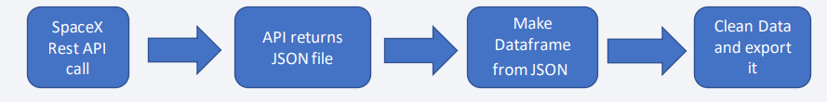
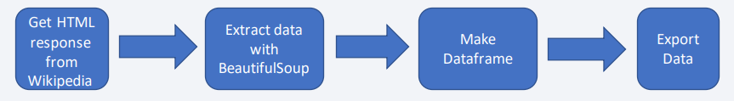
Data Collection
Describe how data sets were collected.
The data sets were collected from SpaceX REST API and from web scrapping Wiki
The API produced info on rockets, launches, and payload
Web scraping Wiki also produced rockets, launches, and payload information

Slide 8
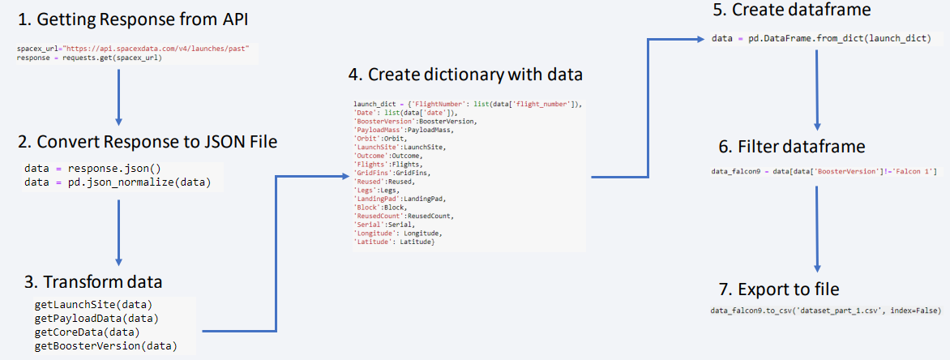
Data Collection – SpaceX API
GITHUB link

Slide 9
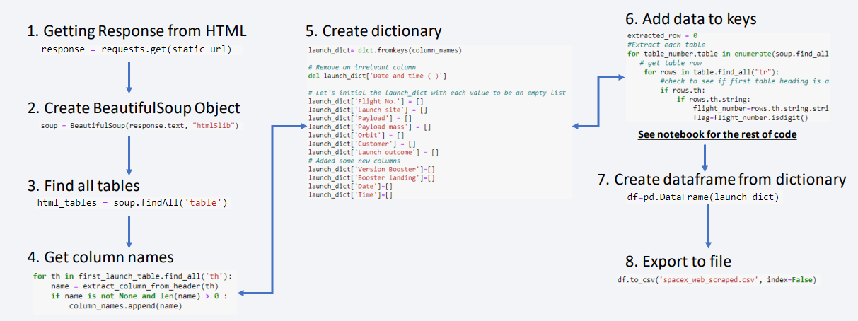
Data Collection - Scraping
GITHUB link

Slide 10
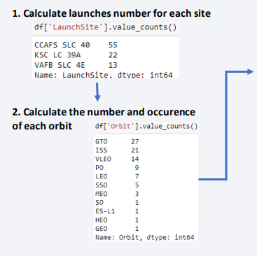
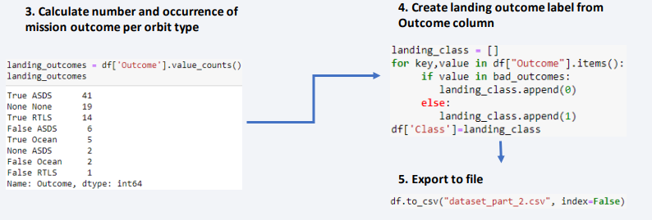
Data Wrangling
GITHUB link
The dataset showed that there were several cases where the booster didn’t land successfully
I also transformed strings into categorical variables, 1 meaning success and 0 is failure

Slide 11
EDA with Data Visualization
GITHUB link
Scatter Graph
Flight Number vs Payload Mass
Flight Number vs Launch Site
Payload vs Launch Site
Orbit vs Flight Number
Payload vs Orbit
Scatter plots show relationships between variables
Line Graph
Success Rate vs Year
Shows data vars and their trends
Bar Graph
Success Rate vs Orbit
Shows the relationships between numeric and categorical vars

Slide 12
EDA with SQL
GITHUB link
SQL queries were used to gather and understand data from the dataset
Display
Names of the launch sites
First 5 records starting with “CAA”
Total payload carried by boosters from NASA
Avg payload carried by booster F9
List
Date of first successful landing outcome on ground pad
Names of the boosters that have success in drone ship
4000 < MASS < 6000
Number of successful/failure mission outcomes

Slide 13
Build an Interactive Map with Folium
GITHUB link
Folium is a map that I centered around NASA Space Center
Red circle at NASA Johnson Space Center's coordinate with label showing its name
Red circles at each launch site coordinates with label showing launch site name
The grouping of points in a cluster to display multiple and different information for the same coordinates
Markers to show successful and unsuccessful landings. Green for successful landing and Red for unsuccessful landing
Markers to show distance between launch site to key and plot a line between them
13

Slide 14
Build a Dashboard with Plotly Dash
GITHUB link
My dashboard has a dropdown, pie chart, range slider, and a scatter plot
Dropdown allows a user to choose the launch site or all launch sites
Pie chart shows the total success and the total failure for the launch site chosen with the
Range slider allows a user to select a payload mass in a fixed range
Scatter chart shows the relationship between two variables, in particular Success vs Payload Mass

Slide 15
Predictive Analysis (Classification)
GITHUB link
Data prep
Load dataset, normalize data, then split the data into training and testing sets
Model prep
Select proper ML models, set parameters, then train models with the training data set
Model eval
Find best hyperparameters for each model type, computer accuracy for each model with the testing set, then plot the confusion matrix
Model comp
Compare the models according to their accuracy and the model with the best accuracy is chosen

Slide 16
Exploratory data analysis results
Interactive analytics demo in screenshots
Predictive analysis results
Results

Slide 17

Section 2

Slide 18
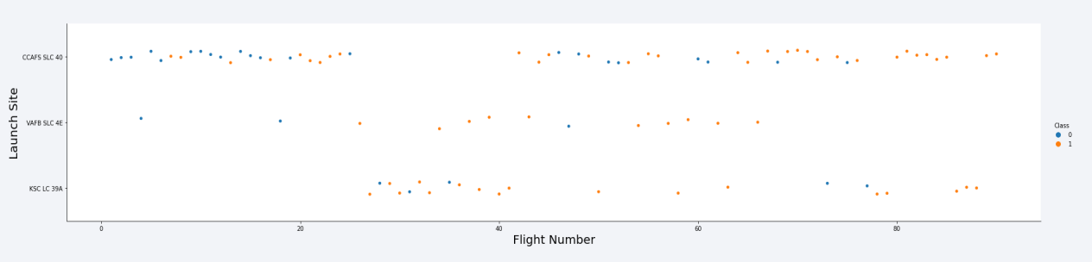
Flight Number vs. Launch Site
• The earliest flights all failed while the latest flights all succeeded
• The CCAFS SLC 40 launch site has about a half of all launches
• VAFB SLC 4E and KSC LC 39A have higher success rates
• It can be assumed that each new launch has a higher rate of success

Slide 19
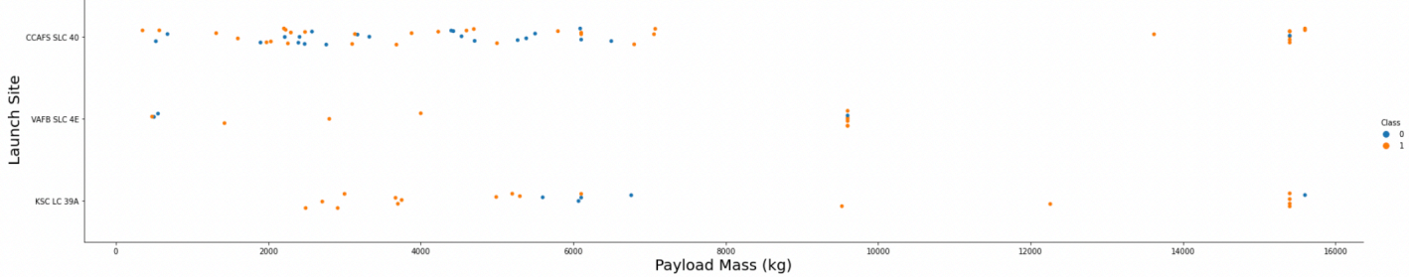
Payload vs. Launch Site
• For every launch site the higher the payload mass, the higher the success rate
• Most of the launches with payload mass over 7000 kg were successful
• KSC LC 39A has a 100% success rate for payload mass under 5500 kg too

Slide 20
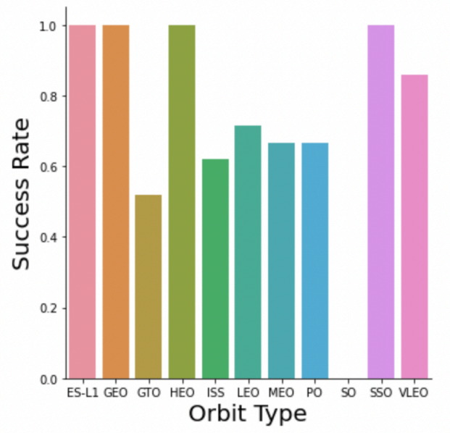
Success Rate vs. Orbit Type
100% Success rate
ES-L1, GEO, HEO, SSO
50%-85% Success rate
GTO, ISS, LEO, MEO, PO, VLEO
0% Success rate
SO

Slide 21
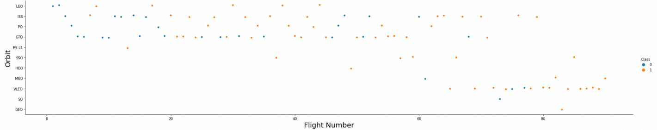
Flight Number vs. Orbit Type
In the LEO orbit the Success appears related to the number of flights; however, there seems to be no relationship between flight number when in GTO orbit.

Slide 22
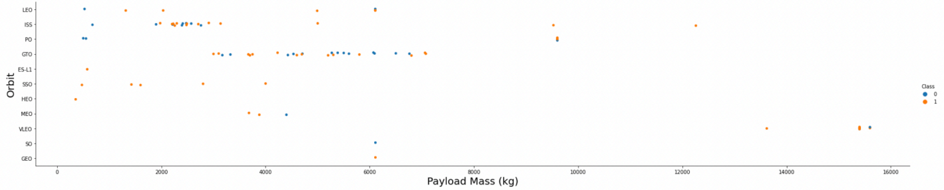
Payload vs. Orbit Type
Heavy payloads have a negative influence on GTO orbits and positive on GTO and Polar LEO orbits.

Slide 23
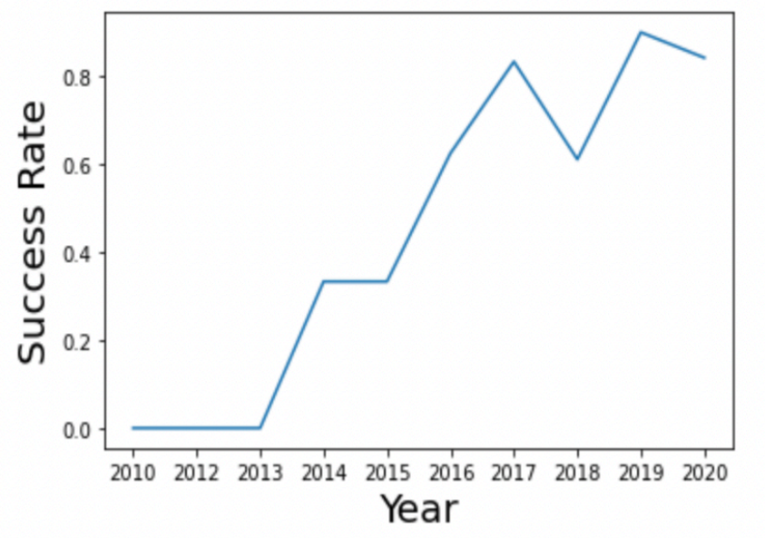
Launch Success Yearly Trend
The success rate increased from 2010 until 2020 with a slight dip in 2018

Slide 24
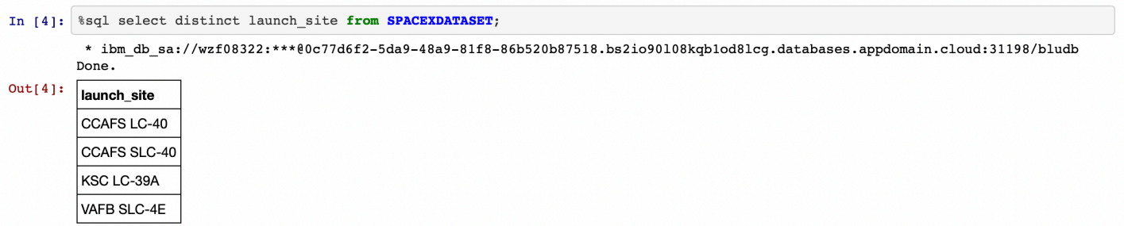
All Launch Site Names
Displaying the names of the unique launch sites

Slide 25
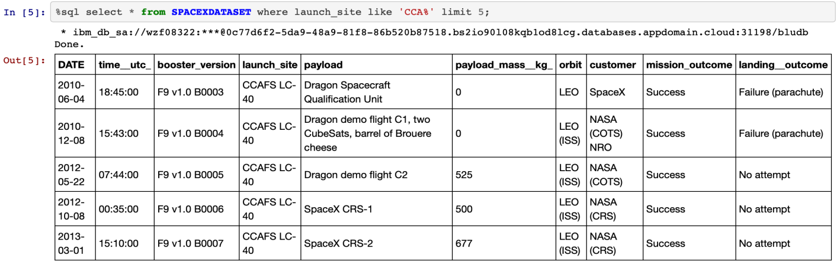
Launch Site Names Begin with 'CCA'
Displaying 5 records where launch sites begin with 'CCA'

Slide 26
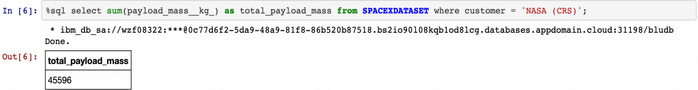
Total Payload Mass
Displaying the total payload mass carried by boosters launched by NASA

Slide 27
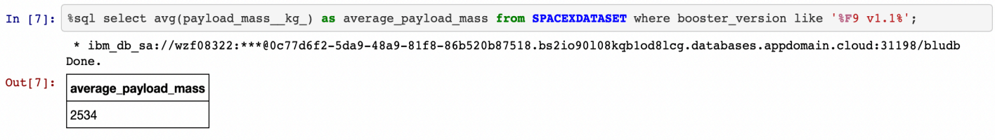
Average Payload Mass by F9 v1.1
Displaying average payload mass carried by booster version F9 v1.1

Slide 28
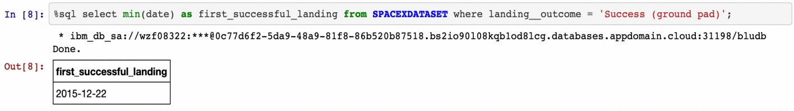
First Successful Ground Landing Date
Listing the date when the first successful landing outcome in ground pad was achieved

Slide 29
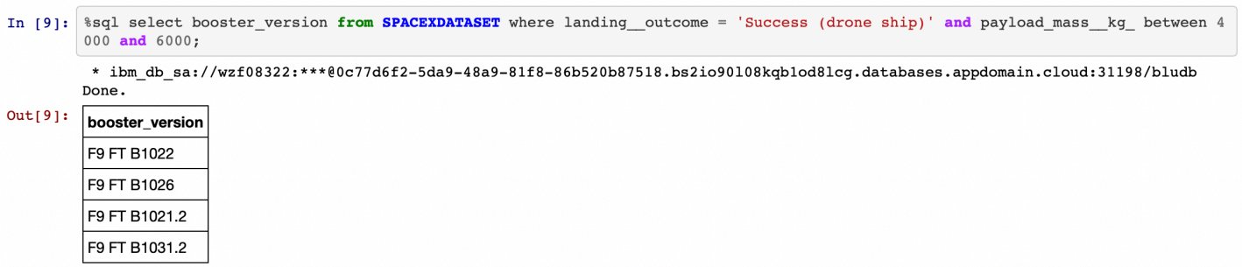
Successful Drone Ship Landing with Payload between 4000 and 6000
Listing the names of the boosters which have success in drone ship and have payload mass greater than 4000 but less than 6000

Slide 30
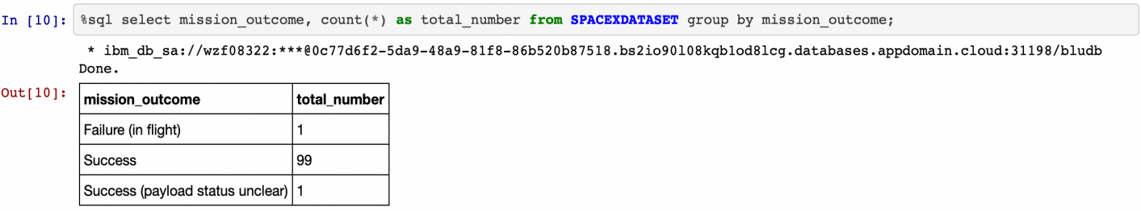
Total Number of Successful and Failure Mission Outcomes
Listing the total number of successful and failure mission outcomes

Slide 31
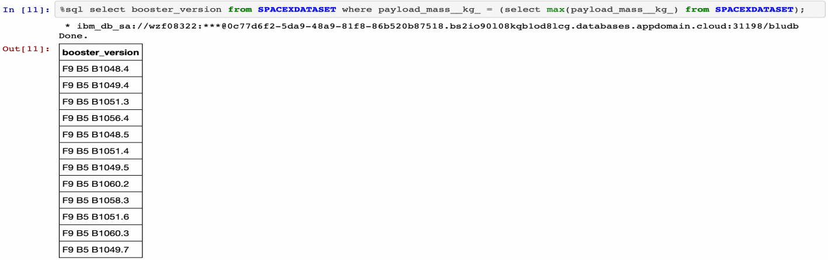
Boosters Carried Maximum Payload
Listing the names of the booster versions which have carried the maximum payload mass

Slide 32
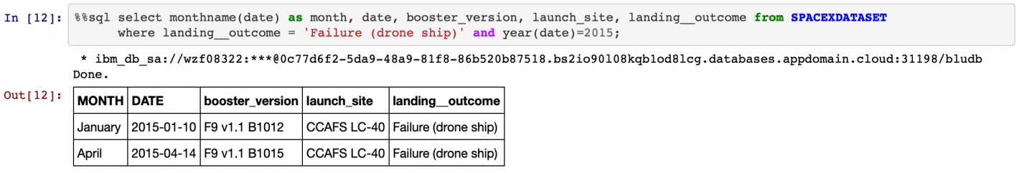
2015 Launch Records
Listing the failed landing outcomes in drone ship, their booster versions and launch site names for the months in year 2015

Slide 33
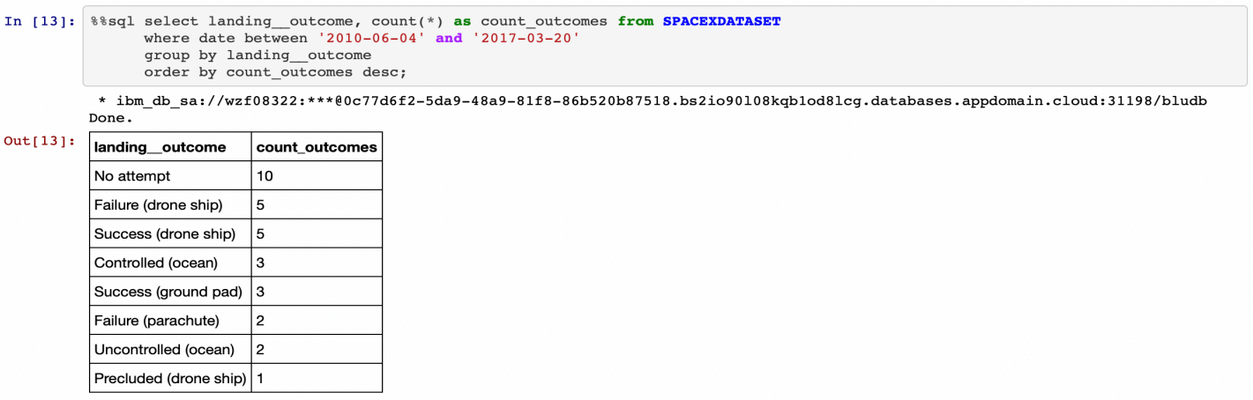
Rank Landing Outcomes Between 2010-06-04 and 2017-03-20
Ranking the count of landing outcomes between the date 2010-06-04 and 2017-03-20 in descending order

Slide 34

Section 3

Slide 35
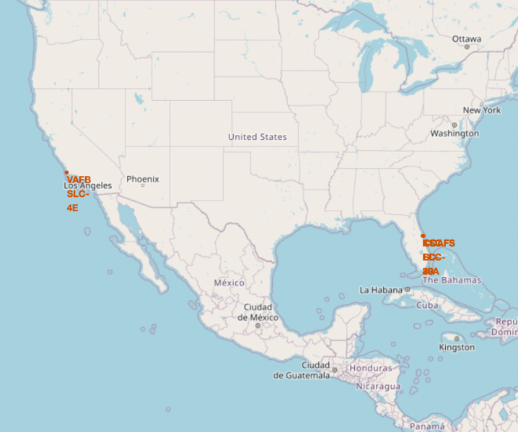
Launch Site Locations
• Most of Launch sites are in proximity to the Equator line. The land is moving faster at the equator than any other place on the surface of the Earth. Anything on the surface of the Earth at the equator is already moving at 1670 km/hour. If a ship is launched from the equator it goes up into space, and it is also moving around the Earth at the same speed it was moving before launching. This is because of inertia. This speed will help the spacecraft keep up a good enough speed to stay in orbit.
• All launch sites are in very close proximity to the coast, while launching rockets towards the ocean it minimizes the risk of having any debris dropping or exploding near people.

Slide 36
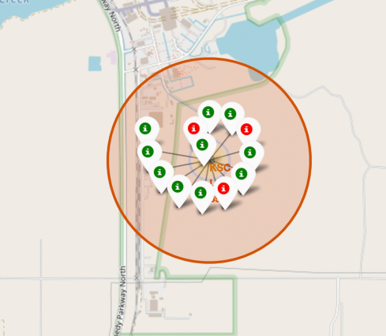
Colored Launch Records
• From the color-labeled markers we should be able to easily identify which launch sites have relatively high success rates.
- Green Marker = Successful Launch
- Red Marker = Failed Launch
• Launch Site KSC LC-39A has a very high Success Rate.

Slide 37
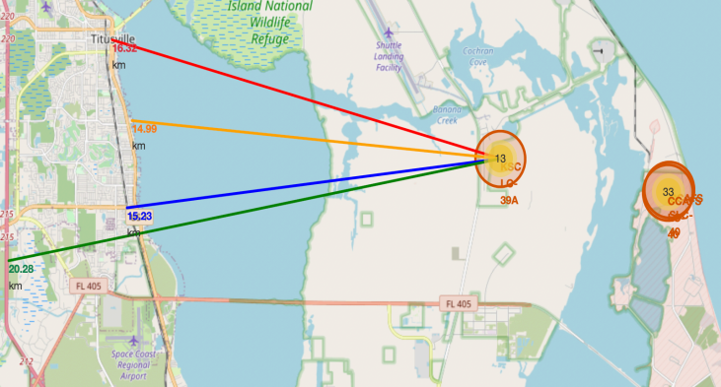
Distance from the Launch Sites
• From the visual analysis of the launch site KSC LC-39A we can clearly see that it is:
- relative close to railway (15.23 km)
- relative close to highway (20.28 km) - relative close to coastline (14.99 km)
• Also, the launch site KSC LC-39A is relatively close to its closest city Titusville (16.32 km).
• Failed rocket with its high speed can cover distances like 15-20 km in few seconds. It could be potentially dangerous to populated areas.

Slide 38

Section 4

Slide 39
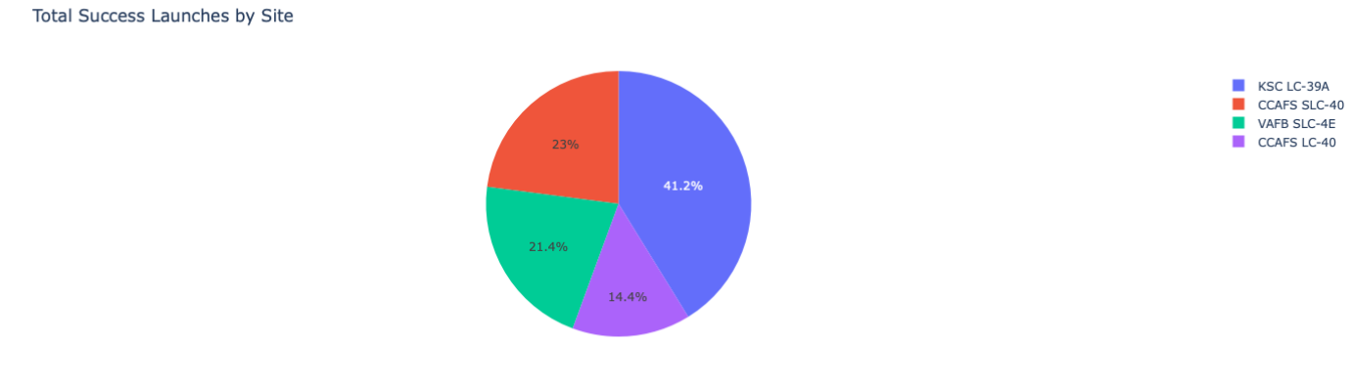
Launch Success Count
The chart clearly shows that from all the sites, KSC LC-39A has the most successful launches.

Slide 40
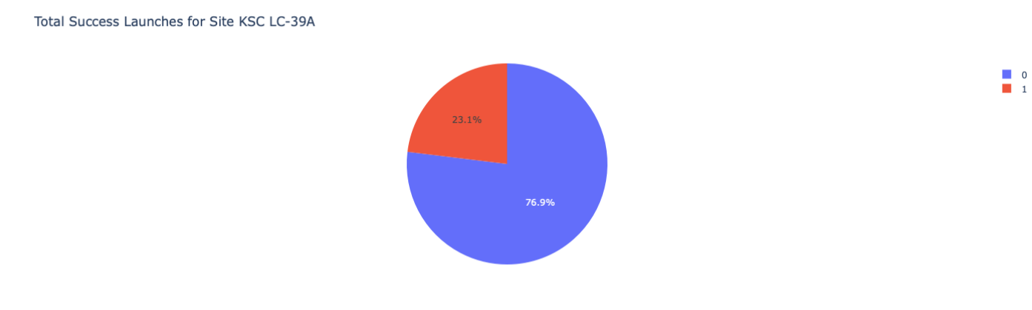
Launch Site Success Ratio
KSC LC-39A has the highest launch success rate (76.9%) with 10 successful and only 3 failed landings.

Slide 41
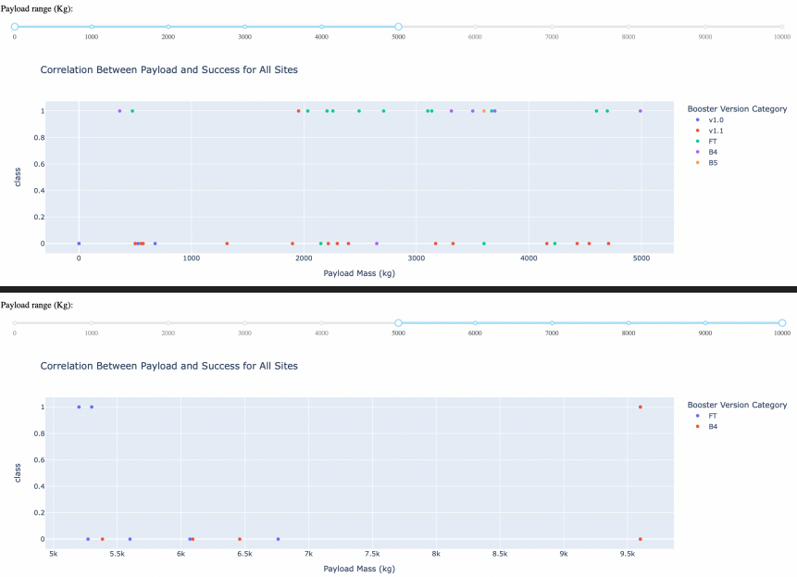
Payload Mass vs Launch Outcome
The charts show that payloads between 2000 and 5500 kg have the highest success rate.

Slide 42

Section 5

Slide 43
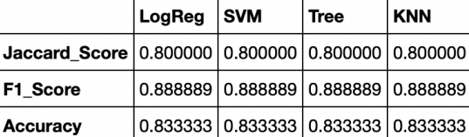
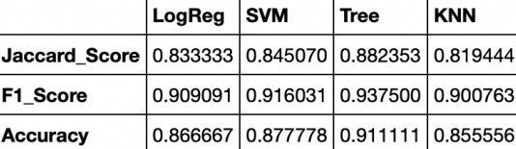
Classification Accuracy
Scores and Accuracy of the Test Set
• We cannot confirm which method preforms best based on the test set.
• Same Test Set scores may be due to the small test sample size. Therefore, we tested all methods based on the whole Dataset.
• The scores of the whole Dataset confirm that the best model is the Decision Tree Model. This model has not only higher scores, but also the highest accuracy.

Slide 44
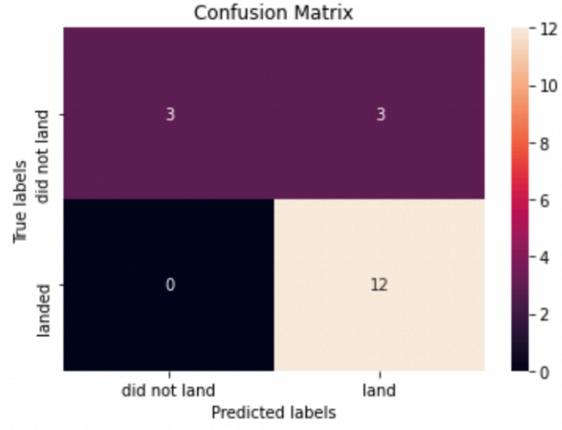
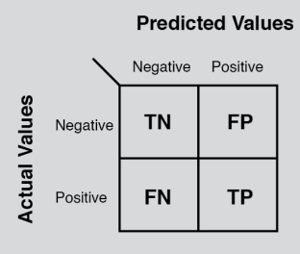
Confusion Matrix
Examining the confusion matrix, we see that logistic regression can distinguish between the different classes. We see that the major problem is false positives.

Slide 45
Conclusions
• Decision Tree Model is the best algorithm for this dataset.
• Launches with a low payload mass show better results than launches with a larger payload mass.
• Most of launch sites are in proximity to the Equator line and all the sites are in very close proximity to the coast.
• The success rate of launches increases over the years.
• KSC LC-39A has the highest success rate of the launches from all the sites.
• Orbits ES-L1, GEO, HEO and SSO have 100% success rate.

Slide 46
Appendix
GITHUB link

Slide 47


